Slide 1

Managed IT Service Offerings

Slide 2
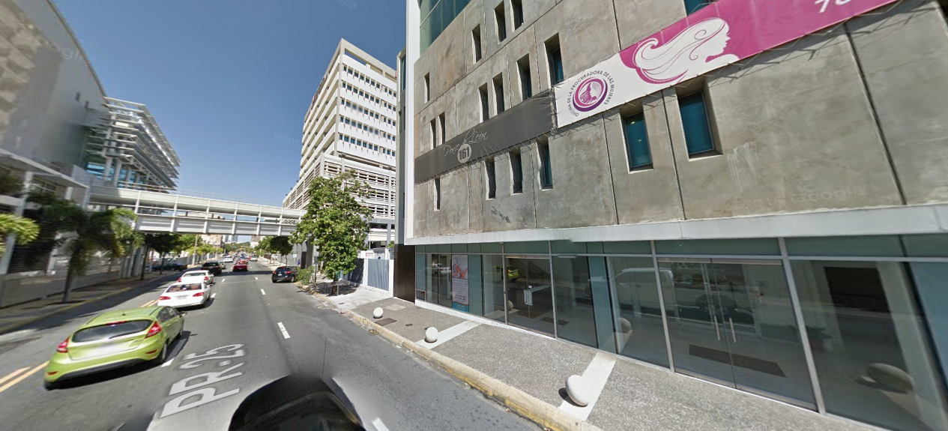
NouvaTech Overview
Near-Shore Outsourcing
Puerto Rico Based
Multiple locations across the U.S
Founded in 2009
Locations
Puerto Rico, HQ
Florida
Michigan
Arizona
California

Slide 3







Executive Summary - What We Do
Managed Services
Document Lifecycle
Solutions
Infrastructure
Modernization
Unified
Communications
Security &
Data Protection
Professional
Services
Technical
Services
Solutions and Services
IT Help Desk
Monitoring
Management
24/7/365
On site response
Remote Support
Backup & Recovery
Endpoint Protection
Move Add Change
Document Mgmt
SharePoint Solutions
Scan Capture
Records Mgmt
Workflow, BPM
Cost Recovery
Print Management
Mobile Printing
File Conversion
IT Assessments
Physical-to-Virtual
Virtual Desktop
Optimization
Private Cloud
Network Planning
Capacity Planning
Exchange Upgrade
Office 365
Voice over IP
Hosted Telephony
Contact Centers
Video Conference
Unified Messaging
Interactive Apps
Digital Signage
Captivation
Mobility BYOD
Security Review
Vulnerability Tests
SOC Monitoring
Firewall Install
Asset Protection
Compliance
Backup & Recovery
Endpoint Protection
E-mail security
Solution Design
Software Installation
Network Upgrades
Data Migration
Capacity Planning
Server Assessments
Storage Upgrades
SharePoint Services
ECM Deployment
Field Break Fix Svcs
Device Configuration
Procurement
Staff Augmentation
FlexServ Support
Custom Engineering
Service Desk
OEM Manufacturing
Wiring Build outs

Slide 4

Nouvatech Client Engagement Method
Organizational Teams & Objectives
Solution Specialist
Qualify & Determine Criteria
Pre Sales Analyst
Gather Data Prepare & Deliver Assessment
Project Management
Solution Hypothesis
Present Solution
Service Delivery
Execute SOW
Completion
Help Desk
Design
Develop
Discover
Assess
Propose
Deploy
Validate
Support
Engagement Steps
Best Practice Output
Advanced App
Walk through
Stakeholder Discussions
Assumptions
Requirements Analysis
Dependencies
Current Costs
SOW Outline
Preliminary Costs
Team Staffing
Engage Partners
Build Solution
Demonstration
Gather Feedback
Project Plan
Validate Reqmnts
Solution Design
Project Plan
Project Costs
Solution Costs
Services Plan
Transition Plan
Onboarding Plan
Gain Commitment
Proof of Concept
Formal kick off
Commit Resources
Manage Project
Checkpoint mtgs
Installation, Integration, Migration steps
Change Control
Test and cut over
Go live readiness
Complete training
Knowledge trnsfr
Status reporting
Quarterly reviews
Compliance audit
Satisfaction Survey
Project sign off
Complete billing
Help desk hand off
Review SLA
Policy & Procedure
Brief call center
Prepare TiNA
Post project review
Client review
Introduce new technology

Slide 5
Managed Services – 3 Packages
SILVER
Includes unlimited remote support for users. This package is perfect for clients who are looking for a full-service remote support organization, but do not require on-site support.
GOLD
Includes unlimited remote support and onsite support during business hours. This is appropriate for most clients who want a simple, turn-key outsourced IT department.
PLATINUM
Includes unlimited remote and on-site support. After-hours emergency support for critical systems is included as is encryption software licensing and management. This package is perfect for mission-critical, high-security or regulated environments where IT mishap could have serious consequence.

Slide 6
Managed Services – 3 Packages
 | SILVER | GOLD | PLATINUM
Support | Unlimited Remote | Unlimited Remote 8-5 Onsite | Unlimited Remote 8-5 Onsite Emergency Onsite 1/3 Turn Encryption SW
Network Operations Center (NOC) | Remote Monitoring & Alerting Phone System Mgt. | Remote Monitoring & Alerting Phone System Mgt. | Remote Monitoring & Alerting Phone System Mgt. Remediation
Technology Consulting (vCIO) | 1 CIO Meeting / Qtr. | 1 CIO Meeting / Qtr. | 1 CIO Meeting / Qtr.
Project Services | Available | Available | Available
Cloud Services | Available | Available | Available

Slide 7
Outsourced IT Delivery Model
Strategy
(1) Support
(3) Technology Consulting (Virtual CIO)
Remote Helpdesk
Onsite Services
How-to Questions
Business Impact of Technology
Technology Summary
Design Desk
Budget Planning
Support
(2) Centralized Services (NOC)
Monitoring
Patch Management
Anti-Virus / Anti-Malware
Backup & DR
Cloud Management
Regular Backup Restore Testing
Proactive Technology Management
Cyber Security Hardening
Disaster Recovery Planning
Infrastructure

Slide 8




Sample Onboarding Timeline
Average onboarding up to 30 Days
Sign Contract
Onsite Team Established
Critical Documentation hand off from customer
In-Depth Assessment
Backup
A/V
Monitoring
E-Mail Security / Continuity
Transition to NOC
Review In-Depth Assessment
100% Documentation
1st IT Steering Committee Meeting
Prioritized Tactical Plan
Begin Proactive Administration
People
Process
Technology
Data

Slide 9
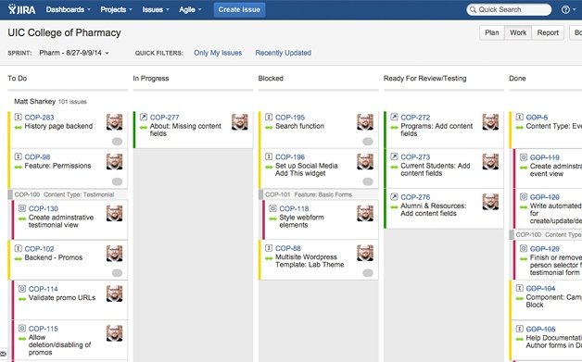
Client Onboarding
Near-Term Support – Onsite Team
Confirm Backups are 100%
Critical Documentation
Deep Environmental Assessment
Deploy NouvaTech MIT Best Practices
First IT Steering Committee Meeting
Service Activation
*Agile project management using Jira

Slide 10
Support

Slide 11
Help Desk Services
Client Support
Unlimited remote helpdesk (service desk)
Remote Operations Center (ROC)
Ticketing system with full metrics managed by AutoTask
Asset and audit management
End-user device management including patching and enterprise anti-virus/anti-malware supported by Sophos
Sophos and Bit-Defender for end-point and email protection
Infrastructure Monitoring and Management
24/7 Monitoring & alerting
Problem resolution
Management
Proactive maintenance (patching / firmware updates)
Minor upgrades
Vendor Management

Slide 12

Service Requests
Created via e-mail, phone, desktop agent or web portal
Tickets are logged and given a unique ID
Progress is updated and comments with technicians via email
In an emergency, call the Help Desk

Slide 13
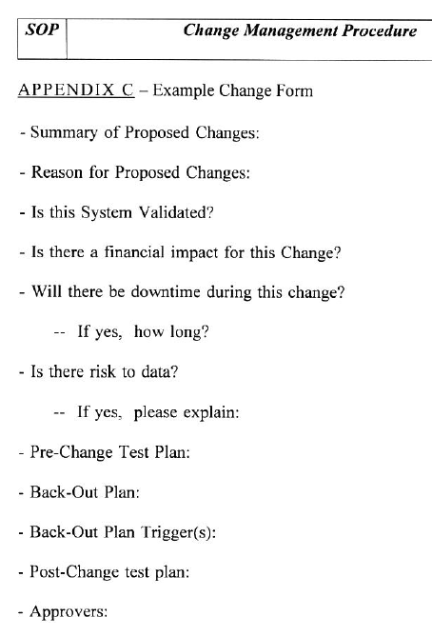

Change Control
80% of outages are caused by unapproved changes - Gartner
All changes to production systems are documented
Risks are reviewed prior to changes
Back-out plans are made to mitigate the unknown
Changes are reviewed to ensure they are complete and tested

Slide 14
NOC
Network Operations Center

Slide 15
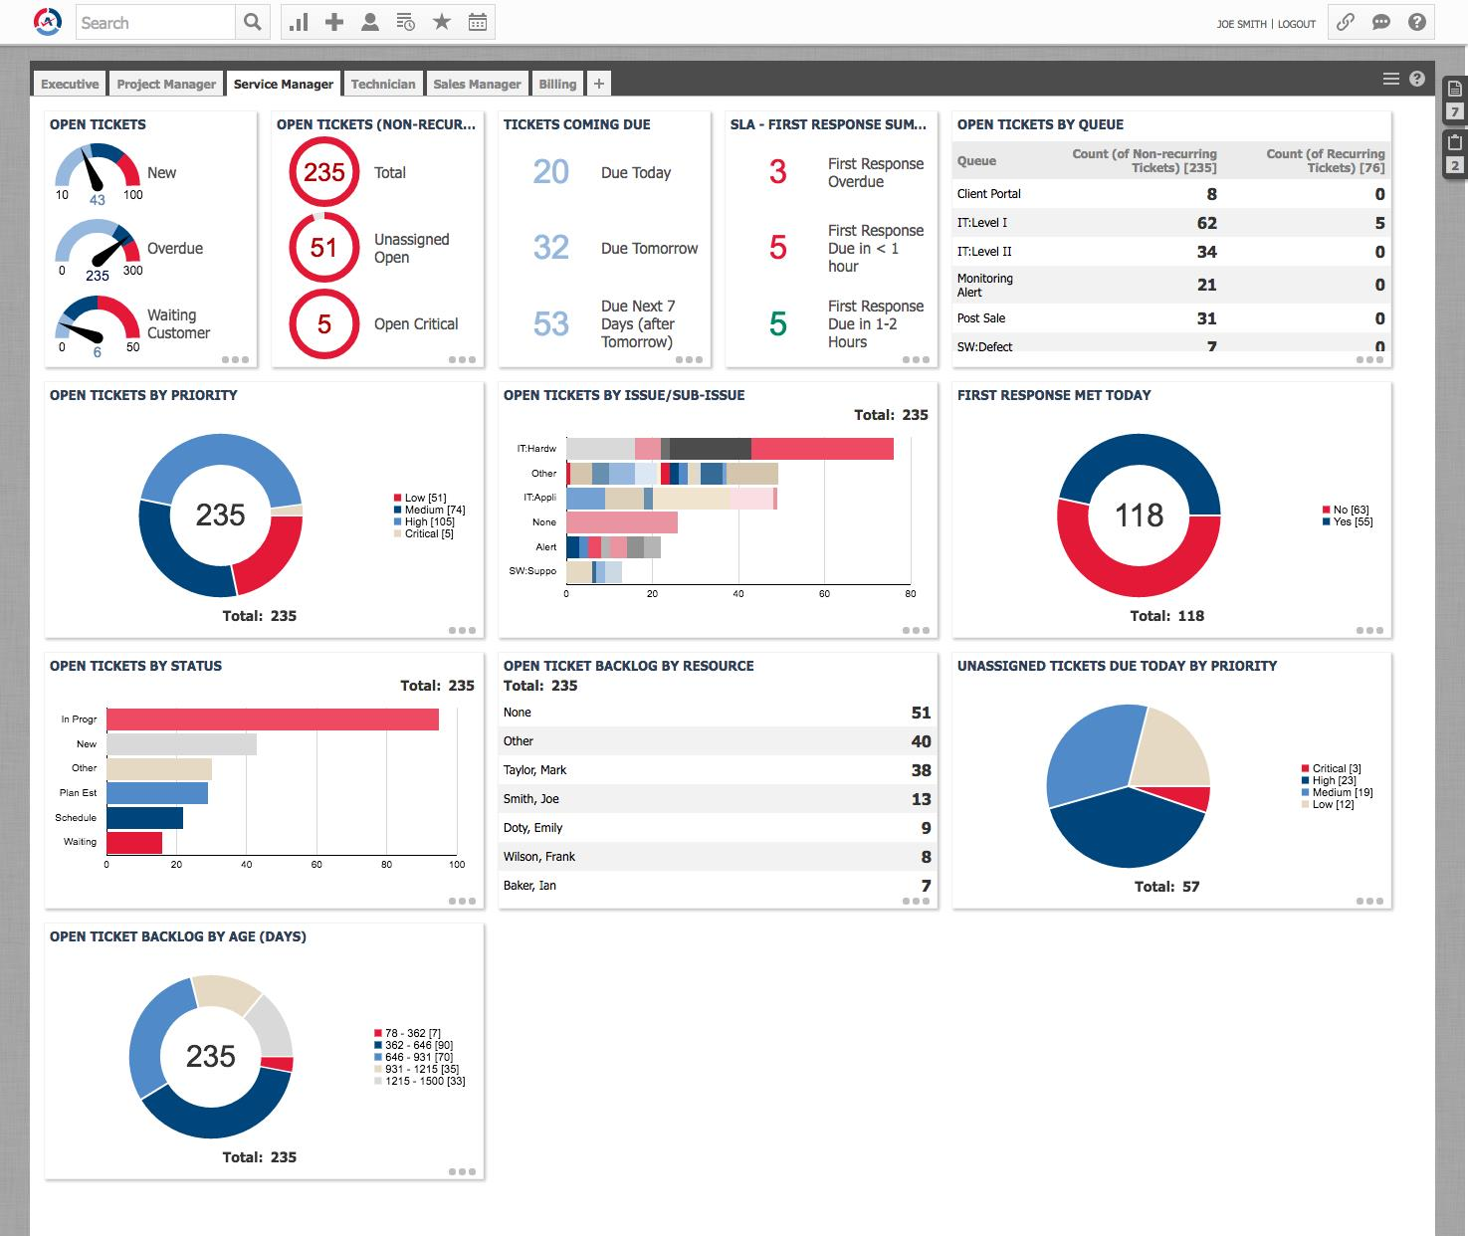
Autotask 24x7 Monitoring
Autotask Secure Platform
Servers and network equipment are monitored 24x7x365
Alerts and thresholds are tailored to each client
Self-healing is available if appropriate
Disk, processor and common process monitoring standard
Custom monitoring available

Slide 16
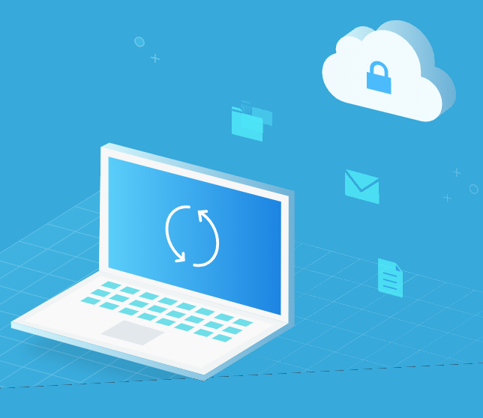
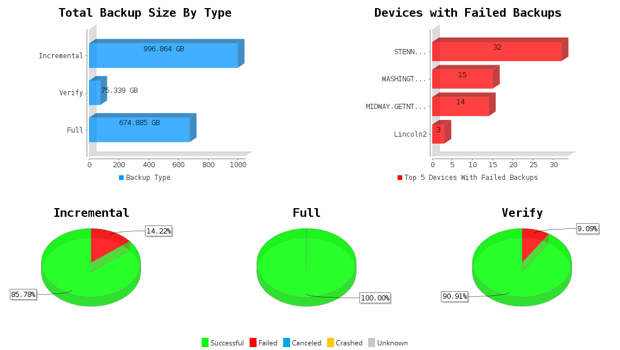
Backup and DR Management (Add On’s)
Continuous backup monitoring and management
Supports on-site hardware and software
Alerts configured for failed or hung backup jobs
Regular test restores
Disaster support

Slide 17
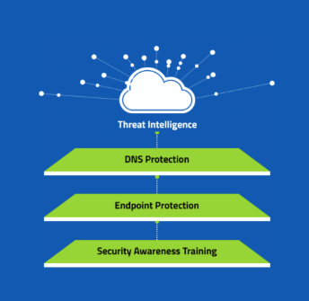
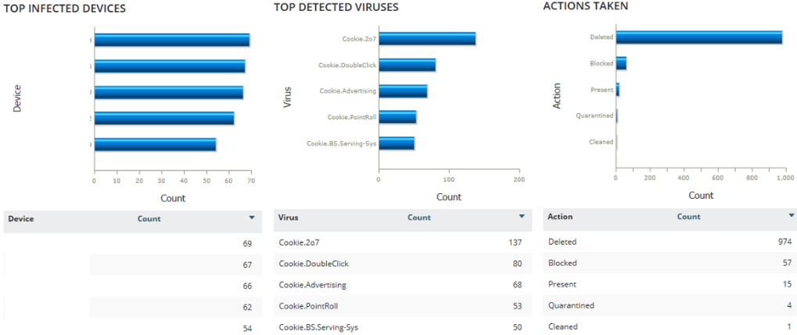
Anti-Virus Management
Industry-leading Anti-virus software
Includes Anti-virus license
Deployed on Endpoints and Servers
Continuous monitoring
Alerts notify NOC of outbreaks or out-of-date software

Slide 18
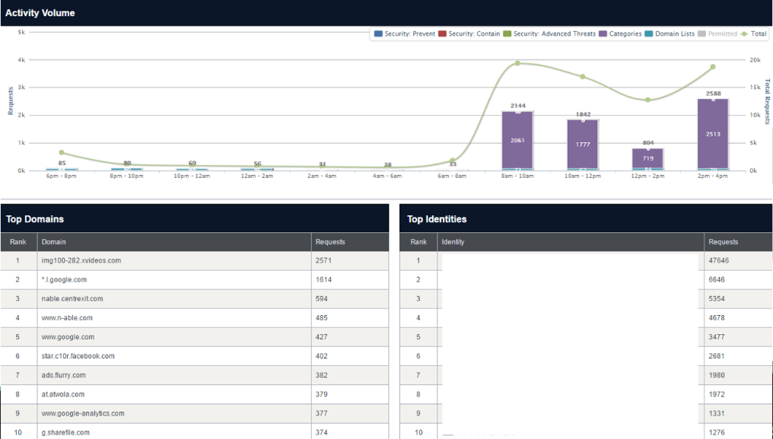
Content Security and Filtering
Industry-leading DNS Security software
Sophos Cybersecurity
Includes Enterprise license
Deployed on client networks
Cloud DNS filtering protects against malware and inappropriate websites
Detailed reporting

Slide 19





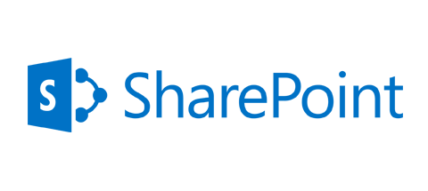
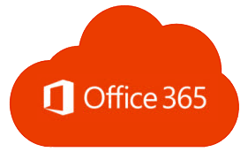

Primary Business Applications
Support for Application operation and administration
Client is responsible for business practice and use of the application
Support for user provisioning and de-provisioning
Patching support
Upgrade and Migration support available

Slide 20








Infrastructure Management
Cloud
Virtualization
Storage
Servers
Networks
E-Mail
Active Directory
DNS / Network Services
Windows / Linux / IOS

Slide 21
Virtual Chief Information Officer (vCIO)
VCIO/ Quarterly Reviews

Slide 22
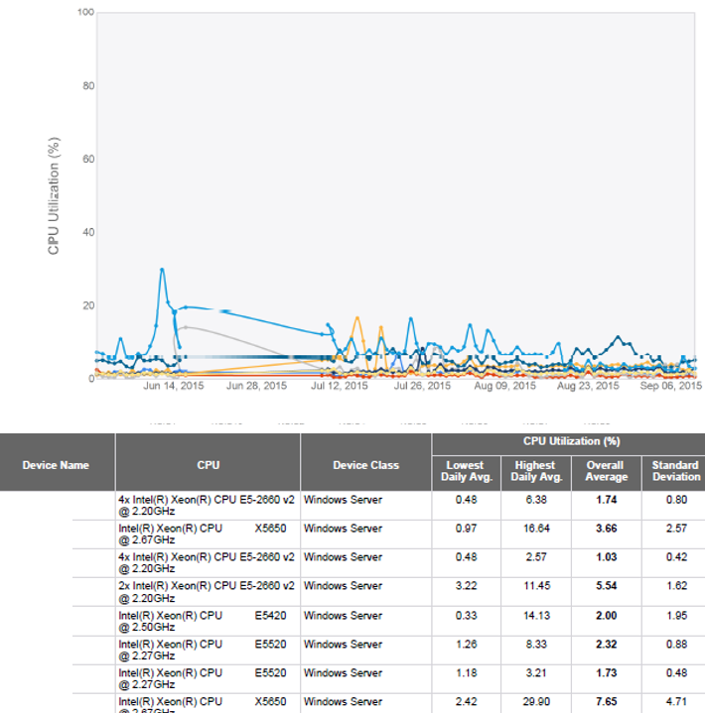
System Metrics and Reporting
Custom Run-Book Created for Each Client
System Monitoring and Alerts setup to your needs
Ad-hoc reporting available on all key indicators
NOC ready to assist in data interpretation

Slide 23
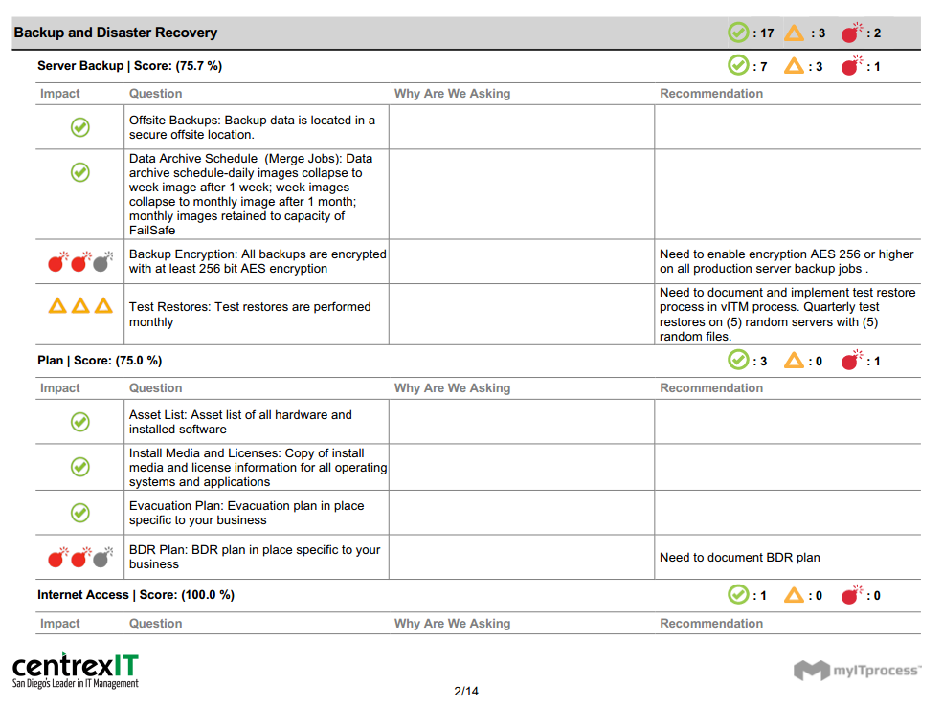

150 – Point Quarterly Inspection
vITM performs monthly checks
150 checks each quarter
vITM reviews results with vCIO
Any priority issues are surfaced immediately
Health Checks are reviewed with client every quarter

Slide 24
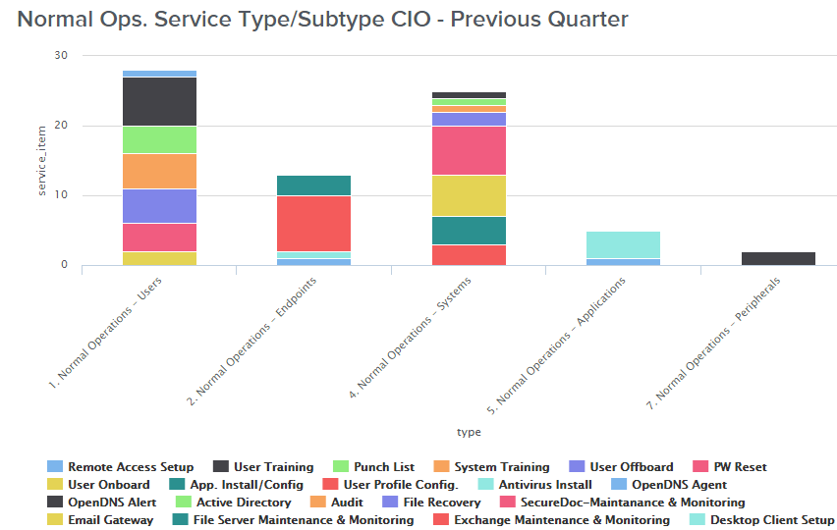
Quarterly vCIO Meeting
Led by vCIO
Reviews key metrics, projects and known risks
Reviews requirements and priorities
Checks for alignment with all ongoing IT activities
Adjusts IT strategy and tactics based on changes in business strategy or situation

Slide 25
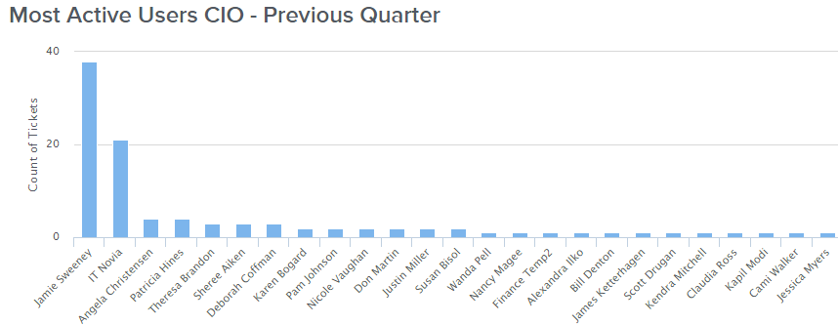
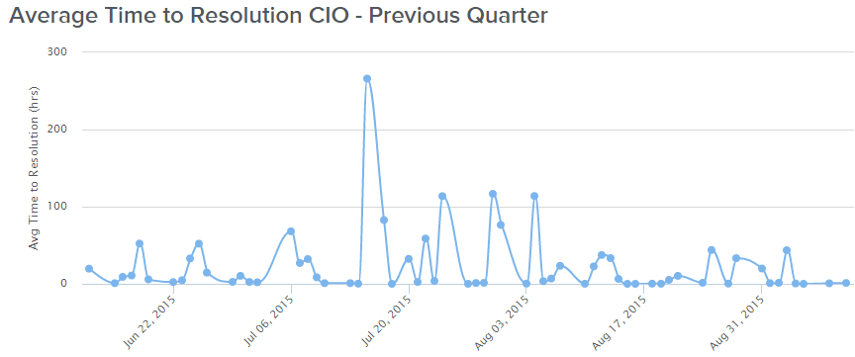
Executive Reports and Metrics
Most active users
Asset Management / Budgeting
IT Response and Resolution Metrics
Backup Test Evidence
Uptime
Project Alignment Updates

Slide 26
QUARTERLY ACCOUNT REVIEWS
Why:
To keep our customers happy and overly satisfied
Quarterly meetings are set in advance to conduct account reviews to ensure we are exceeding expectations and getting ahead of any new initiatives
Proactively monitoring the account, looking at usage patterns, over and underutilization
Who:
Our Reps, located in the US, dedicated account managers for your account
Can be reached at any time via e-mail: Dthompson@nouvatech.com and/or
cell phone: XXX-XXX-XXXX

Slide 27



Endpoint Management
Hardware & Software Procurement
Endpoint Provisioning*
Endpoint Replacement
* Normal replacement provisioning included in all packages.

Slide 28

Encryption
Included In:
Silver
Gold
Platinum
Encryption licensing and management for endpoints
Centralized key management
Secure provisioning
End User Support
Included in Platinum; can be added to any package

Slide 29
Outsourced IT Team Packages & Pricing
 | Silver Partial Fixed Fee | Gold Partial Fixed Fee | Platinum Full Fixed Fee
1. Support (Phone & Email Support) | Unlimited Remote | Unlimited Remote | Unlimited Remote & Onsite
2. Centralized Services (NOC) (Monitoring & Preventative Systems) | Available | Available | Available
3. Technology Consulting (vCIO) (Budget Planning & Road Mapping) | Available | Available | Available
Project Services (Moves, Adds, & Changes) | Available | Available | Available
Cloud Services (Hosted Virtual Servers) | Available | Available | Available
On Boarding & Project Management (One Time Fee)
Cost Per User
Monthly Recurring MIT (36 Months)

